Slide 1

Creating a Sales Funnel for an Education MSME
BDM CAPSTONE PROJECT
Bhavya Aditya
Roll No: 21f3001442
IITM Online BS Degree Program

Slide 2


Organization Background
NCR Eduservices Pvt Ltd is a Noida-based education sector MSME dealing in both B2B and B2C segments.
B2B
B2C
Outsourcing partner
Teacher recruitment
Curriculum design
Quality control
Content creation
One to one tuition
Group classes
K12 tuition
College tuition
India
MENA
USA
UK & Europe
Australia

Slide 3
Problem Statement
Build a B2C sales funnel to identify stages with maximum attrition
Analyze demand and conversion subject and education level wise
Understand customer behaviour causing attrition
Suggest data driven strategies to increase conversion
Explore potential market opportunities

Slide 4
Customer Behavior & Preferences
Top reasons of attrition: not interested, prefer offline classes, enrolled elsewhere
Rescheduled trial unlikely to convert
Weekdays (Mon-Wed) have higher preference over weekends
Considerable proportion of leads (38%) flexible on scheduling—open to any day.

Slide 5
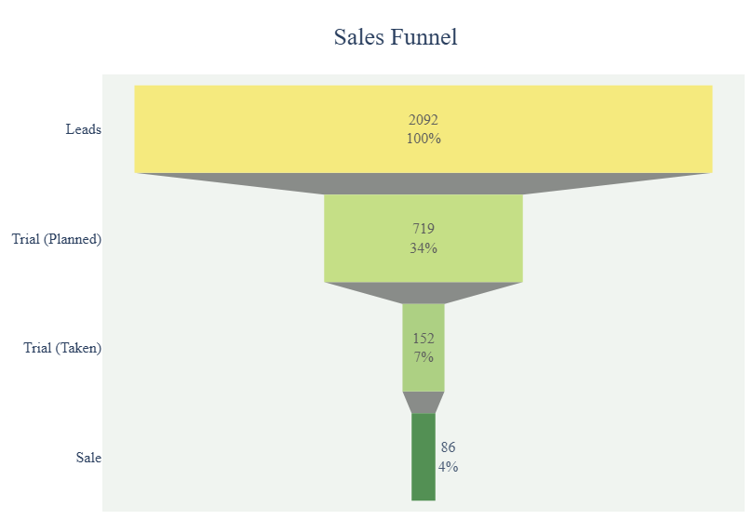
Results from
Sales Funnel
34% leads plan a trial - highest attrition here
7% leads take a trial class
Only ~3% leads converted into sales
Good trial-to-sale conversion rate (43%)

Slide 6
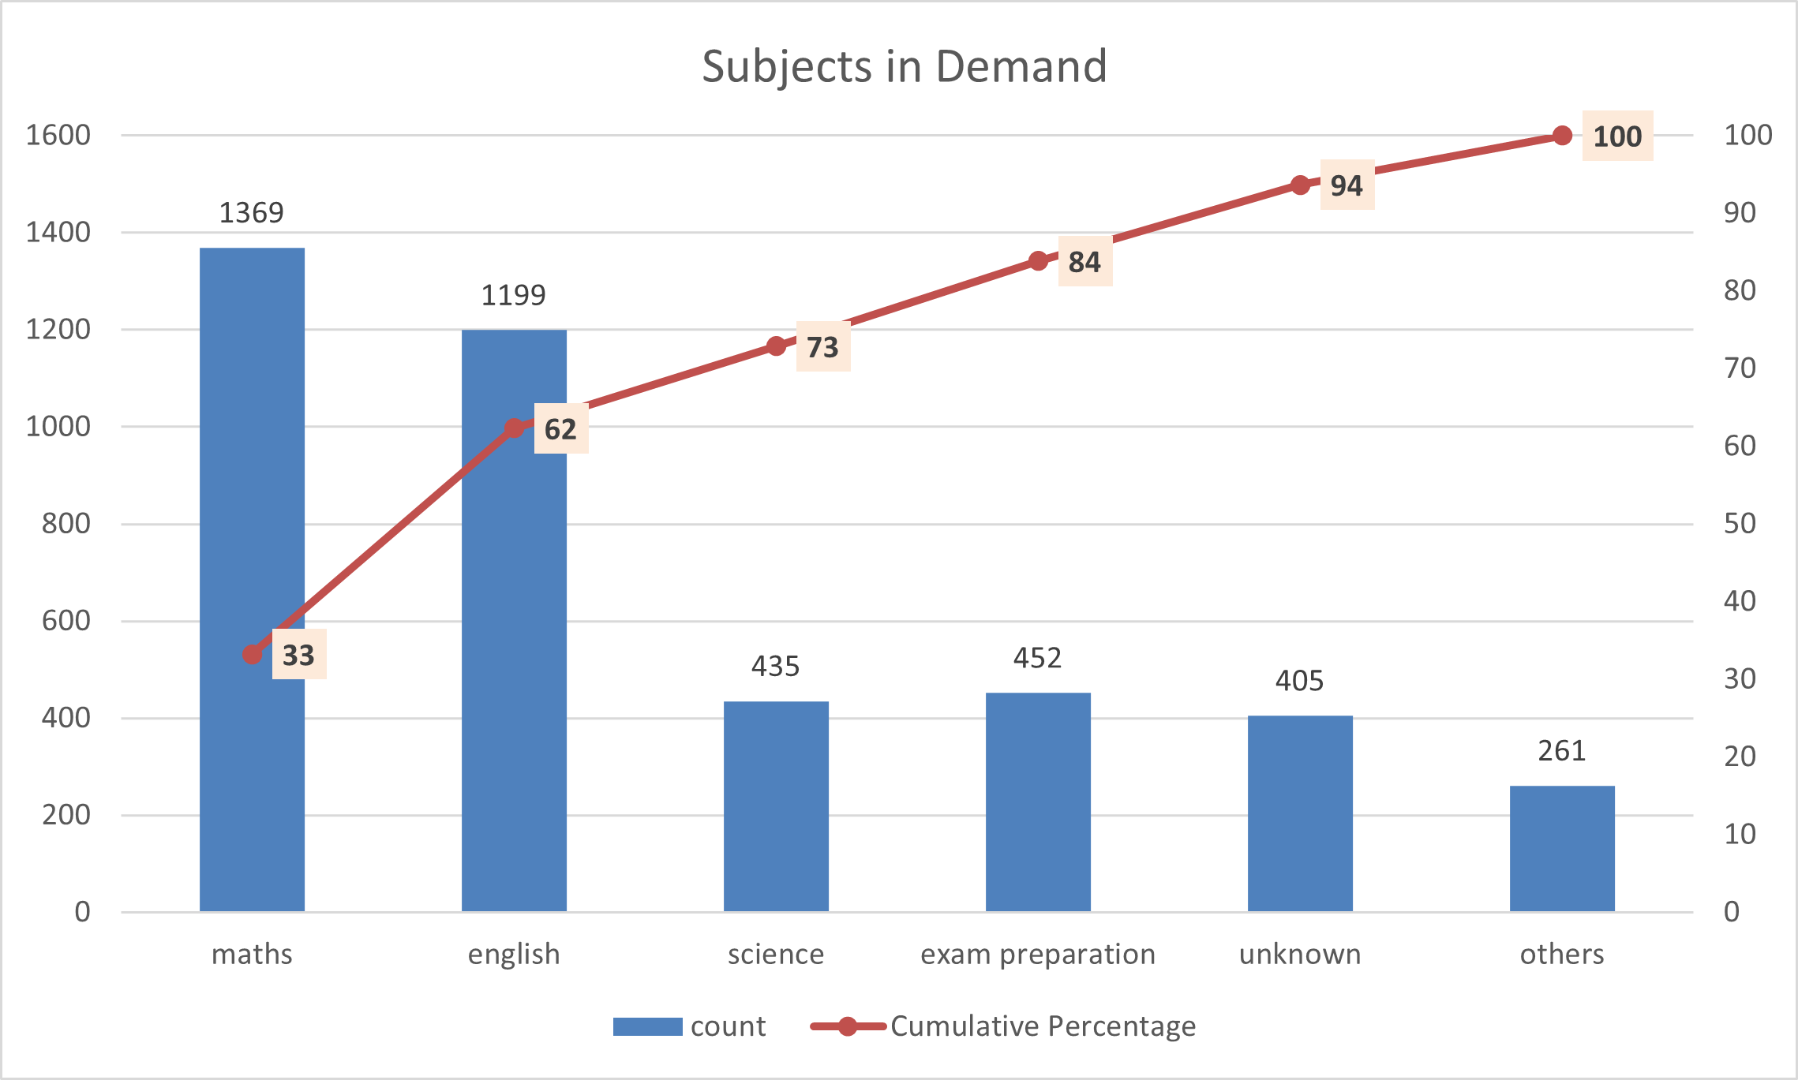
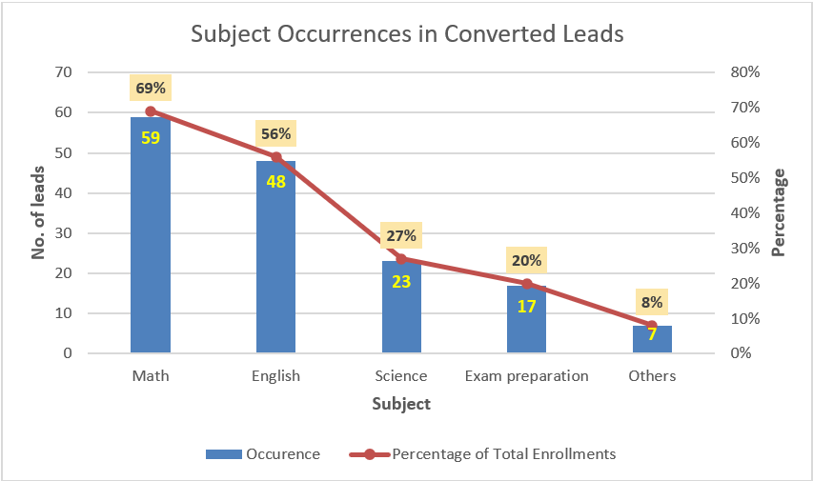
Subject Wise Demand and Enrollment
Math and English are the highest demanded as well as sold subjects, followed by science

Slide 7
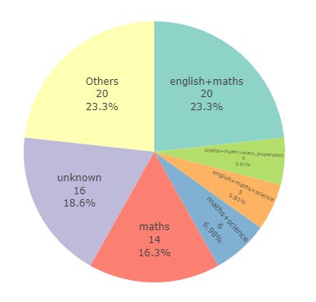
Prominent Subject Combinations
Top Enrolled Subject Combinations
Maths plus English is the most sold combination
80% of science and English enrolments also enrol in maths
83% of science enrolments also enrol in maths and 81% of English enrol in maths.
Converse is not true. Math can be bundled with science or English.

Slide 8
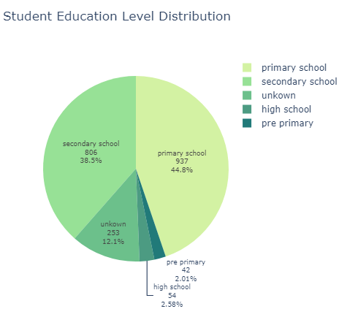
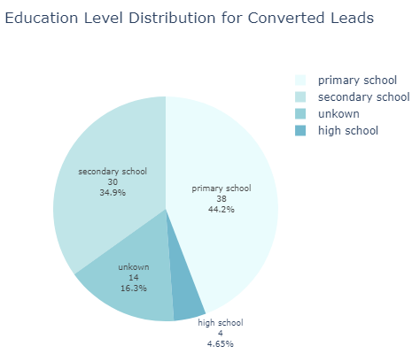
Analysis of Education Level
Primary school is leading category followed by secondary, in demand as well as sales.
High school has the highest conversion rate (7.4%) when overall conversion rate is ~4%.

Slide 9
Market Opportunities
Already existing market with teachers available
Less leads (54) but highest conversion rate (7.4%)
Explore Exam Preparation
Expand High School Segment
Qualification exam for teachers in Australia
School level exams in Australia
Existing teacher base is trainable
LANTITE
NAPLAN & ATAR

Slide 10
Recommendations
Improve lead quality and targeting
Specialize in LANTITE, NAPLAN, ATAR
Expand high school segment
Bundle math with English and science

